Slide 1
People Counting And Tracking System
PRESENTED BY:
TEAM NO:0015
18UK1A0518- Gowroju Laxmi priya
18UK1A0567- Challakonda Srichandana
18UK1A0523- Junnuthula Akshaya
18UK1A0531- Manda Manasa

Slide 2
OUTLINE
Introduction
Objective
TECHNICAL ARCHITECTURE
Project flow
ALGORITHM
Implementation
WEB application
Output images
conclusion

Slide 3
Introduction
Real-time people flow estimation can be very useful to gain insights for many commercial and non-commercial applications. Counting people on streets or at entrances of places is indeed beneficial for security, tracking, and marketing purposes. People counters can be used to monitor occupancy of entire buildings, individual rooms or anything some of the application where you can implement people counters are
Retail stores and supermarkets
Higher education
Corporate workplaces
Restaurants, hospitality and leisure facilities
Washrooms
In this project we develop a people counter device to count the number of pedestrians walking through a door or corridor through a video or camera.

Slide 4
Objective
After Completing this project we will be able to Use Python, Deep learning and Computer vision concepts
MobideSSD detection model
Flask Web Framework
Object Tracking
Object Detection
The objective of this project is to develop a people counter device to count the number of pedestrians walking through a door or corridor through a video or camera..

Slide 5
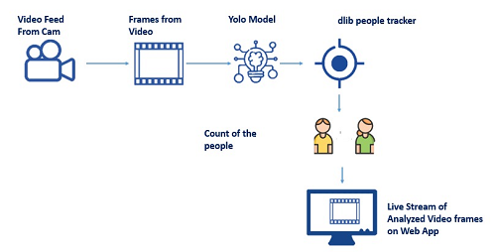
TECHNICAL ARCHITECTURE

Slide 6
PROJECT FLOW
This project has two phases, phase 1 is to implement detection of person and the second phase is to implement tracking of a person.
Phase1: Person Detection
Get the camera / Video Feed
Detect people in the frame using the caffe pre-trained model
Localize the pedestrians in the frame
use the detected person bounding box coordinates to track them
Phase 2: Tracking Phase:
create an object tracker for each detected object to track the object as it moves around the frame
continue tracking until the N-th frame is reached and then re-run our object detector The entire process repeats

Slide 7
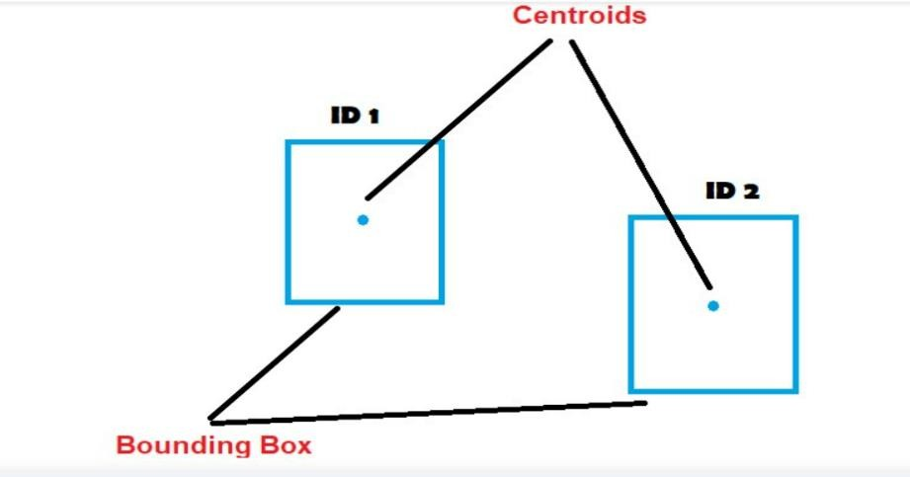
ALGORITHM
Centroid Tracking Algorithm
Multiple processes are involved in the centroid tracking algorithm, we will go with each and every step in this activity.
Step1: Computing the centroids from the boundary boxes retrieved from Mobilenet SSD Object detection algorithm
Step2: calculating the euclidean distance between the existing object's bounding boxes and new object's bounding boxes
Step 3: update the x,y coordinates of existing objects
Step4: Register the newly detected objects
Step5: Deregister old Objects

Slide 8
IMPLEMENTATION
Implementing People Counter
With all the support files and packages, we build our OpenCV people counter.
This section allows you to implement the people counting system.

Slide 9
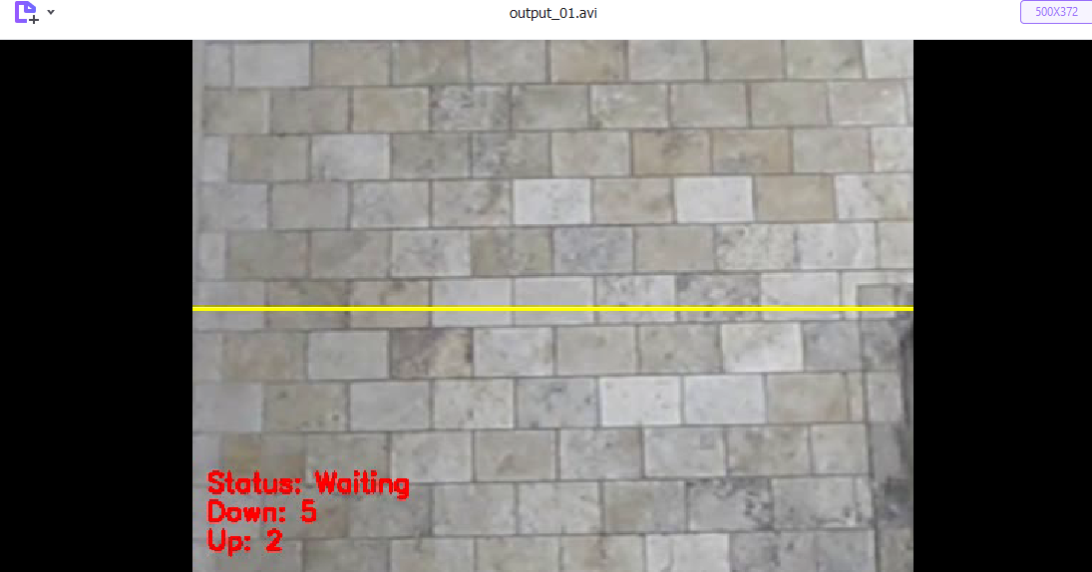
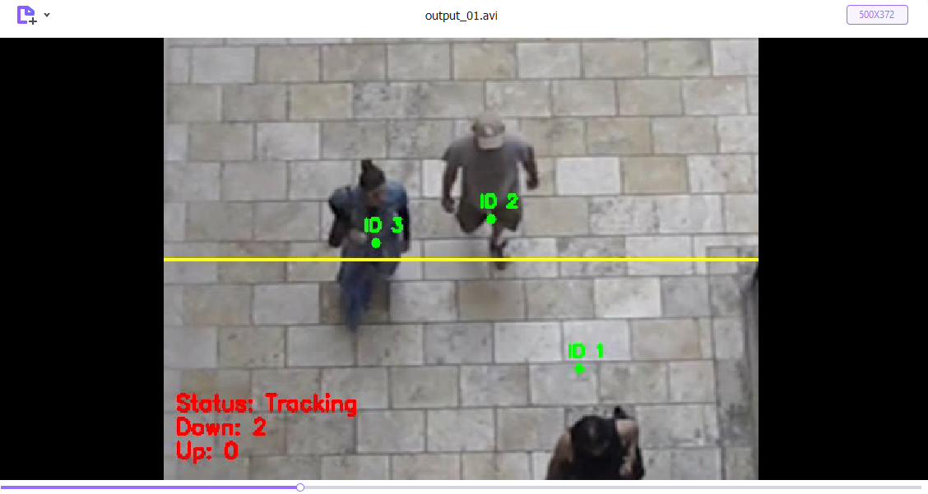
OUTPUT IMAGES

Slide 10
WEB APPLICATION
Build Application
In this Activity, we will be building a web application that is integrated into all the files we have created in the above Milestones.
A UI is provided for Where the live stream/ video stream of social distancing violations are showcased.

Slide 11
CONCLUSION
We develop a people counter device to count the number of pedestrians walking through a door or corridor through a video or camera. Most of the time, this system is used at the entrance of a building so that the total number of visitors can be recorded. Live stream of visitors flow is streamed on to a web application.
Overhead closed-circuit television camera, or IP camera, tracks people's movements.
The camera connects to a people counter which accurately detects and records how many people pass through the counting zone.
Most of the time, this system is used at the entrance of a building so that the total number of visitors can be recorded. Live stream of visitors flow is streamed on to a web application

Slide 12
THANK YOU

